Slide 1



Beyond Buffer-State Logic
Node-Based Agency in the Caspian–Middle East Conflict Network
Shaoyuan Wu
Global AI Governance and Policy Research Center · EPINOVA LLC
1ST RCASBC INTERNATIONAL CONFERENCE 2026 · SESSION 19
13 September 2026
Notes:
Good afternoon. My name is Shaoyuan Wu, from the Global AI Governance and Policy Research Center at EPINOVA LLC.
Today I will present my paper, “Beyond Buffer-State Logic: Node-Based Agency in the Caspian–Middle East Conflict Network.”
The paper examines how middle and small states may exercise agency through strategically consequential connections in contemporary networked conflict.
This argument was developed through three cases across the Caspian–Middle East conflict network.

Slide 2

Shaoyuan Wu, Ph.D., M.S., LL.M., B.S.
Director, Global AI Governance and Policy Research Center, EPINOVA LLC
Specially-invited Associate Professor, Sun Yat-sen University
Assistant Professor, National Institute for South China Sea Studies
Email: sywu@epinova.org
ORCID: 0009-0008-0660-8232
Notes:
Here is the short bio.

Slide 3
CONTENTS
01
Definition and Analytical Unit
02
Conceptual Framework
03
Three cases
04
Implications
05
Conclusion
Notes:
The presentation contents five parts.

Slide 4
1. Definition and Analytical Unit
Buffer-State Question
How does territorial position between stronger powers constrain a state’s options?
Position
Connection
Control
Effect
Routes
Bases
Airspace
Sensors
Maintenance
Knowledge
Grant
Condition
Prioritize
Restrict
Deny
Cost
Timing
Posture
Exposure
Options
Node-Based Questions
Which strategic connections can the state govern, and with what effect?
What evidence distinguishes attempted control, implementation, counterpart effect, bargaining benefit, and durable control?
The article shifts the unit of analysis from territorial position to a controller–function–counterpart relationship.
Notes:
Buffer-state approaches explain how territorial position between stronger powers constrains a state's options.
Geography remains important, but contemporary conflict also operates through functional connections: routes, bases, airspace, sensors, maintenance systems, and specialized knowledge.
This produces two additional questions: which strategic connections can the state govern, and with what effect? And what evidence distinguishes attempted control, implementation, counterpart effect, bargaining benefit, and durable control?
The analytical shift is from territorial position to a controller-function-counterpart relationship: who governs an interface, for which function and period, and whose use is changed?

Slide 5
1. Definition and Analytical Unit
Implemented Node-Based Agency
Purposeful use of a consequential node or interface, with relevant control rights, that changes a counterpart’s admissible or effective use.
Controller
Function
Counterpart
Who governs the interface?
Which function, in what period?
Whose use is changed?
Centrality alone does not establish agency. Implementation requires an observed change in admissible or effective use.
Grant
Condition
Prioritize
Restrict
Deny
Boundary actions
Analytical unit: controller–function–counterpart relationship.
Notes:
The concept of implemented node-based agency was defined as the purposeful use of a consequential node or interface, together with relevant control rights, that changes a counterpart's admissible or effective use.
Two distinctions are essential.
Centrality alone does not establish agency, and intention is not implementation.
An important node may create structural opportunity, but implementation requires an observed change in admissible or effective use.
The relevant boundary actions include granting, conditioning, prioritizing, restricting, or denying use.

Slide 6
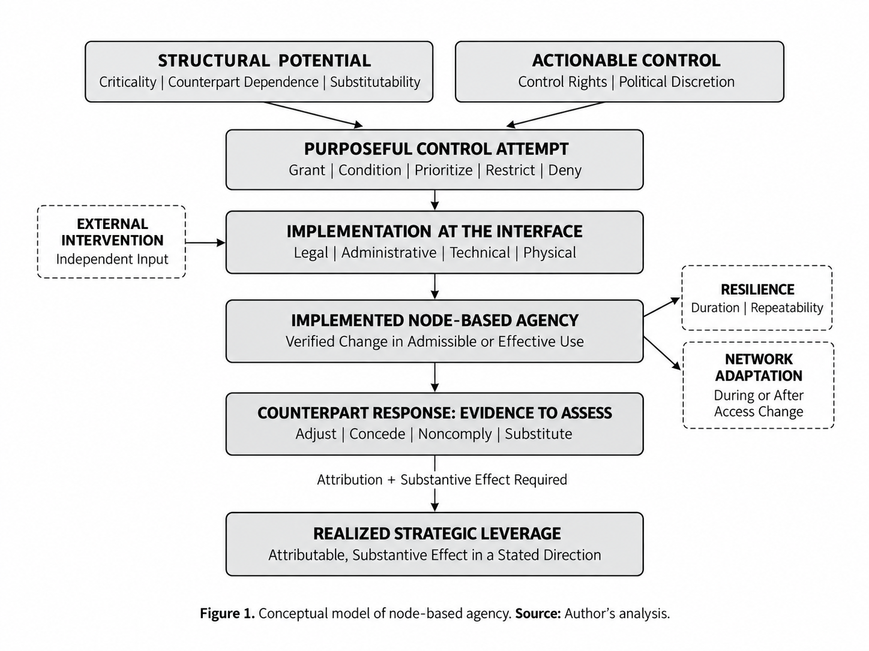
2. Conceptual Framework
Figure 1. Conceptual model of node-based agency. Source: Author’s analysis.
Notes:
The framework separates stages that are often collapsed into a single claim of leverage.
Structural potential is shaped by functional criticality, counterpart dependence, and substitutability.
Actionable control depends on control rights and political discretion. Together, these conditions may enable a purposeful control attempt. The next threshold is implementation at the legal, administrative, technical, or physical interface.
Only a verified change in admissible or effective use establishes implemented node-based agency. Even then, leverage has not yet been demonstrated.
Counterpart responses are evidence to assess, but realized strategic leverage requires an attributable and substantive effect on costs, timing, posture, exposure, or available options. Resilience, network adaptation, and external intervention remain separate dimensions.
The key distinction is therefore simple: potential, implementation, and leverage are not interchangeable.

Slide 7
3. Three Cases: Three cases probe three consequential interfaces
01
02
03
NORTHERN CASPIAN
GULF ACCESS
UKRAINE–GULF
Logistics Corridor
Bases and Airspace
Knowledge Interface
Does situational criticality translate into purposeful smaller-state control?
Does host-state authorization alter a stronger actor’s operational access?
Can delivered expertise generate leverage across provider–recipient relationships?
Evidence through 7 September 2026 · Structured comparison for concept development · Not designed to test necessary or sufficient conditions
Notes:
The comparison probes three consequential interfaces. The northern Caspian asks whether situational criticality translates into purposeful smaller-state control.
The Gulf case asks whether host-state authorization alters a stronger actor's operational access. The Ukraine-Gulf case asks whether delivered expertise can generate leverage across provider-recipient relationships.
This is an evidence-constrained comparison for concept development, not a test of necessary or sufficient conditions. Evidence is assessed through 7 September 2026.

Slide 8

Case I — Northern Caspian Corridor Power
Core finding
Situational logistics importance, but no demonstrated smaller-state conversion.
22,600 t
loading at Astrakhan
≥3 million t/year combined port capacity
10–15 kt/day scenario range, not observed throughput
Caspian routes preserved selected flows when southern access was constrained.
Control rights were dispersed across ports, customs, rail, scheduling, carriers, and sanctions regimes.
The reported Kazakh barley interruption indicates disrupted usability, not verified purposeful control.
Verdict: structural potential only — purposeful smaller-state implementation and attributable counterpart effect remain unestablished.
Notes:
The northern Caspian illustrates the difference between functional importance and demonstrated control.
When southern access to Iran was constrained, Caspian routes preserved selected flows. Reported grain movements included approximately 22,600 metric tons loaded at Astrakhan, while relevant ports had combined annual capacity above three million tons.
A separate scenario assessment produced a working range of ten to fifteen thousand tons per day, but these are scenario bounds rather than observed throughput.
The evidentiary problem is control. Rights are dispersed across ports, customs, rail, scheduling, carriers, and sanctions regimes.
A reported interruption in Kazakh barley shipments indicates disrupted usability, but not the responsible decision-maker, strategic intent, implementation mechanism, counterpart dependence, or resulting return.
The verdict is therefore structural potential only. Purposeful smaller-state implementation and attributable counterpart effect remain unestablished.

Slide 9
Case II — Gulf Access and Host-State Authorization
Reported and disputed access-policy change
Host-state
authorization
U.S. basing /
airspace use
WSJ-derived reporting indicated that Saudi and Kuwaiti restrictions were lifted in early May.
A White House official reportedly denied that any restriction or ban had existed.
Even if the reported change occurred, its operational consequences remain unverified.
Access not automatic
Mission-specific authorization
Verdict: the most specific reported access-policy change, but implementation remains provisional and counterpart effect unestablished.
Notes:
The Gulf case concerns the most specific reported access-policy change.
Reporting attributed to the Wall Street Journal indicated that Saudi Arabia and Kuwait had restricted U.S. use of bases and airspace and later lifted those restrictions.
A White House official reportedly denied that any restriction or ban had existed, so implementation remains disputed.
The case nevertheless demonstrates that infrastructure presence does not make operational access automatic; host-state authorization can be mission-specific.
Even if the reported change occurred, however, the evidence does not establish a downstream change in mission timing, force posture, cost, exposure, or bargaining outcome.
The verdict is provisional implementation, with counterpart effect unestablished.

Slide 10
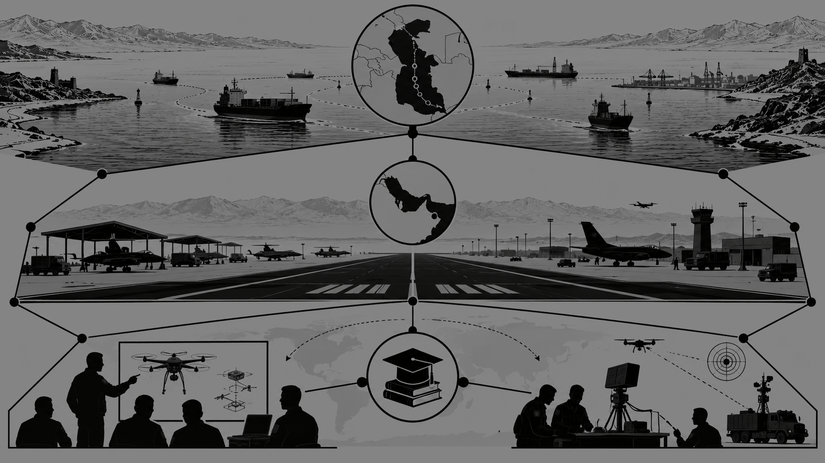
Case III — Ukraine–Gulf Knowledge Interface
Operational counter-drone expertise matched an urgent regional requirement, despite Ukraine’s peripheral geographic position.
Ukraine
expertise
228 specialists
5 Middle East
recipients
Services delivered
Reported 10-year agreements with Saudi Arabia and Qatar; defense cooperation with UAE
Delivery constraints remained; recipient dependence unmeasured
Purposeful provision and recipient selection are established.
Recipient dependence, individualized conditions, direct reciprocity, and durable leverage remain unverified.
The case extends node-based agency beyond physical infrastructure.
Verdict: purposeful provision and partial institutional follow-through; weaker-state leverage remains unestablished.
Notes:
The third case extends the framework beyond physical infrastructure. Ukraine's operational experience against Iranian-designed Shahed systems created a potentially valuable knowledge interface.
On 20 March 2026, Ukraine reported deploying 228 specialists to five Middle Eastern states, establishing purposeful provision and recipient selection.
Reported ten-year defense-cooperation agreements with Saudi Arabia and Qatar, together with defense cooperation with the UAE, indicate partial institutional follow-through.
But recipient dependence is unmeasured, individualized access conditions are not established, direct reciprocity remains unverified, and durable leverage is not demonstrated.
The case therefore shows that specialized knowledge can function as a consequential interface, but it does not establish a complete weaker-state leverage claim.

Slide 11
Cross-Case Findings: Evidentiary Status
Structural
Potential
Implemented
Change
Counterpart
Effect
Negotiated Benefit
Durable
Leverage
Northern Caspian
● Yes
○ No
○ No
○ No
○ No
Gulf Access
● Yes
◐ Provisional
○ No
○ No
○ No
Ukraine Expertise
● Yes
◐ Partial
○ No
◐ Reported / Unverified
○ No
The comparison’s value lies in identifying evidentiary gaps rather than closing them by inference.
Structural potential, implementation, counterpart effect, negotiated benefit, and durability must be established separately.
External intervention indicates exposure and adaptation, not agency or resilience by itself.
None of the cases establishes the full chain of weaker-state strategic leverage.
Notes:
The cross-case comparison produces differentiated results. All three cases exhibit structural potential. The northern Caspian does not cross the threshold into verified implementation.
The Gulf claim is more specific but remains provisional because the underlying reporting is contested. The Ukraine case establishes purposeful delivery and partial implementation, but counterpart effect and durable leverage remain unverified; negotiated benefit is reported but not verified.
The methodological conclusion is equally important: structural potential, implementation, counterpart effect, negotiated benefit, and durability must be established separately. External intervention may indicate exposure and adaptation, but it does not establish agency or resilience by itself.
None of the cases supplies the full chain required for a strong claim of weaker-state strategic leverage. The comparison's value lies in identifying evidentiary gaps rather than closing them by inference.

Slide 12
4. Implications
For middle and small states
Identify the relevant control-rights bundle and protect implementation capacity.
Build redundancy and assess substitutes from the counterpart’s perspective.
Avoid maximizing irreplaceability at the expense of resilience.
For major powers
Treat host-state access as conditional, not automatic.
Incorporate political discretion, retaliation exposure, infrastructure capacity, and substitution costs into planning.
For researchers
Separate control rights, purposeful action, implemented access/use change, counterpart effect, negotiated benefit, durability, external intervention, and adaptation.
Use paired successful and failed conversion cases before drawing causal claims.
Notes:
For middle and small states, strategic relevance requires more than an important location or asset.
They need the relevant control-rights bundle, implementation capacity, redundancy, and an assessment of substitutes from the counterpart's perspective. Maximizing irreplaceability may increase leverage, but it can also reduce resilience.
For major powers, host-state access should be treated as conditional rather than automatic. Planning should incorporate political discretion, infrastructure capacity, retaliation exposure, and substitution costs.
For researchers, control rights, purposeful action, implemented access or use change, counterpart effect, negotiated benefit, durability, external intervention, and adaptation should be coded separately. Stronger causal claims require paired successful and failed conversion cases.

Slide 13
5. Conclusion
Node-based agency is a managed conversion problem.
Structural importance creates opportunity, not agency.
Control rights and implementation convert opportunity into agency.
Attributable counterpart effect is required to establish strategic leverage.
Strategic position does not automatically translate into agency.
Leverage depends on control, implementation, and attributable effect.
Notes:
The conclusion is deliberately bounded. Node-based agency is a managed conversion problem.
Structural importance creates opportunity, not agency. Control rights and implementation convert opportunity into an observed change in use, while strategic leverage additionally requires an attributable and substantive counterpart effect.
The broader implication is that strategic position is not a fixed measure of agency. Agency is relational, functional, and temporally specific. A state may be weak in aggregate terms while exercising control over one consequential connection, or it may occupy an important position without being able to convert that position into agency.
Strategic position therefore does not automatically translate into agency, and leverage must be demonstrated rather than inferred. Thank you.

Slide 14
Thank you!
Notes:
Thank you

